Slide 1
CGB1221 – DATABASE MANAGEMENT SYSTEM
Department of Artificial Intelligence and Data Science
Academic Year: 2024 – 2025 (Even Semester)
Register Number : 2303811724321115
Name : Surya S
Year : II Year
Semester : IV
Section : B
Date : 04-06-2025

Slide 2
Project Title
TEMPLE DHARSHAN BOOKING APPLICATION

Slide 3
PRESENTATION OVERVIEW
Problem Identification
Objective
Flow Diagram
Module Description
Module Implementation
Screenshot
Conclusion and Future Enhancement

Slide 4
Problem Identification
In many temples, the traditional method of booking Darshan slots is either offline or unorganized online systems, causing:
Long queues and wait times.
Manual errors in managing slots.
Lack of payment tracking or cancellation options.
No centralized database for managing temple visits.

Slide 5
OBJECTIVE
To design and develop a Temple Darshan Booking App that:
Enables users to register and log in securely.
Allows online Darshan booking with date, temple, and time selection.
Supports online payment with transaction confirmation.
Offers user profile with current and past bookings.
Includes an integrated booking cancellation with refund feature.
Uses Gradio + SQLite + Python backend for quick deployment and ease of use.

Slide 6
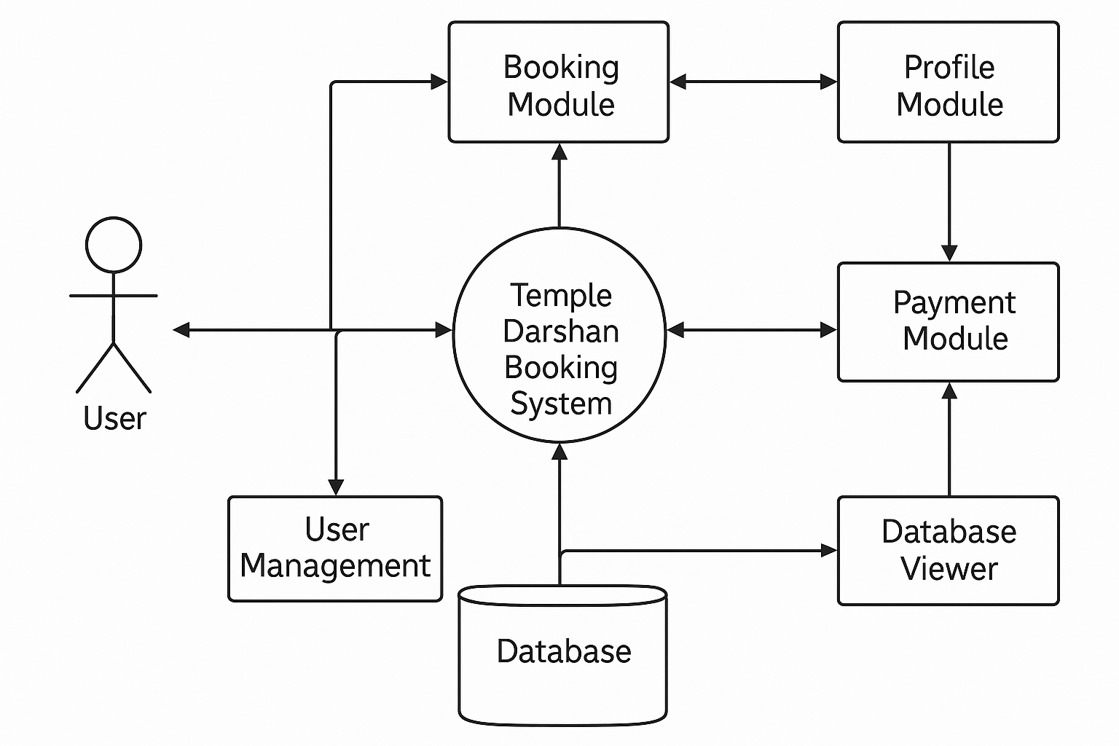
Flow Diagram

Slide 7
Modules Description
Module | Description
User Management | Handles user registration and login with validation.
Booking Module | Users can select temple, date, and slot and confirm booking.
Payment Module | Simulated ₹100 payment per booking with visual confirmation.
Profile Module | Displays user’s current, future, and past bookings.
Cancel Booking | Lets users cancel their bookings and receive 80% refund.
Database Viewer | Admin can view all records stored in SQLite database.

Slide 8
Module Implementation
Frontend: Built with Gradio UI for rapid development and testing.
Backend: Python handles user actions and logic.
Database: SQLite manages users and bookings with relationships.
Session Handling: User ID retained via session variable for personalized views.
Session Handling: User ID retained via session variable for personalized views.

Slide 9
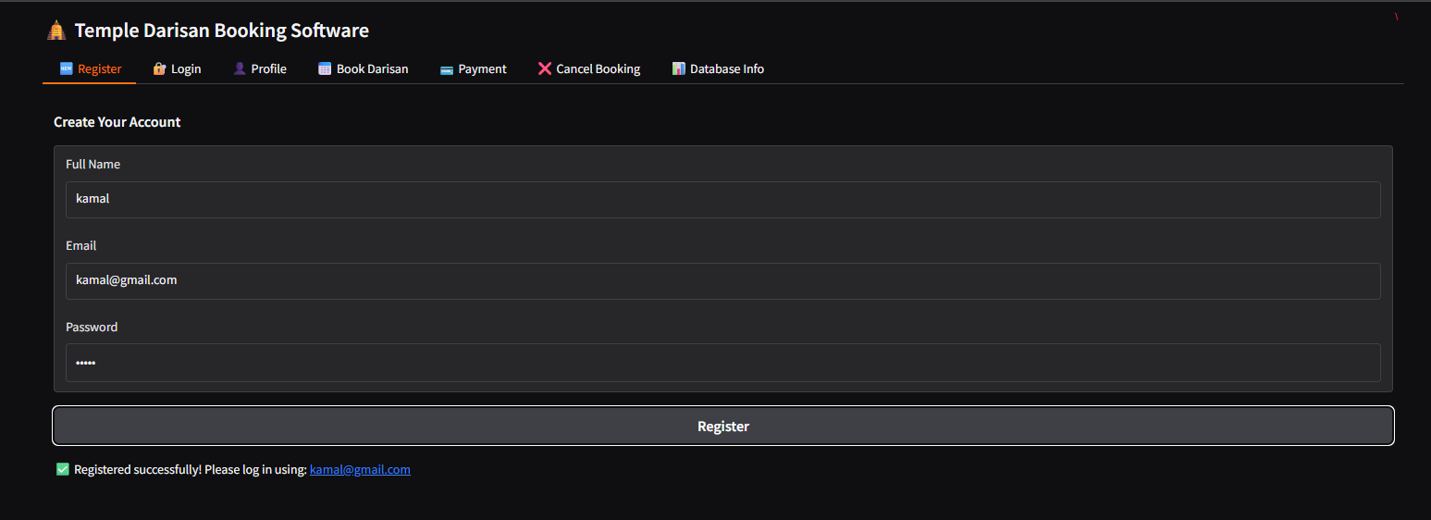
Screenshot
User Management (Register & Login)

Slide 10
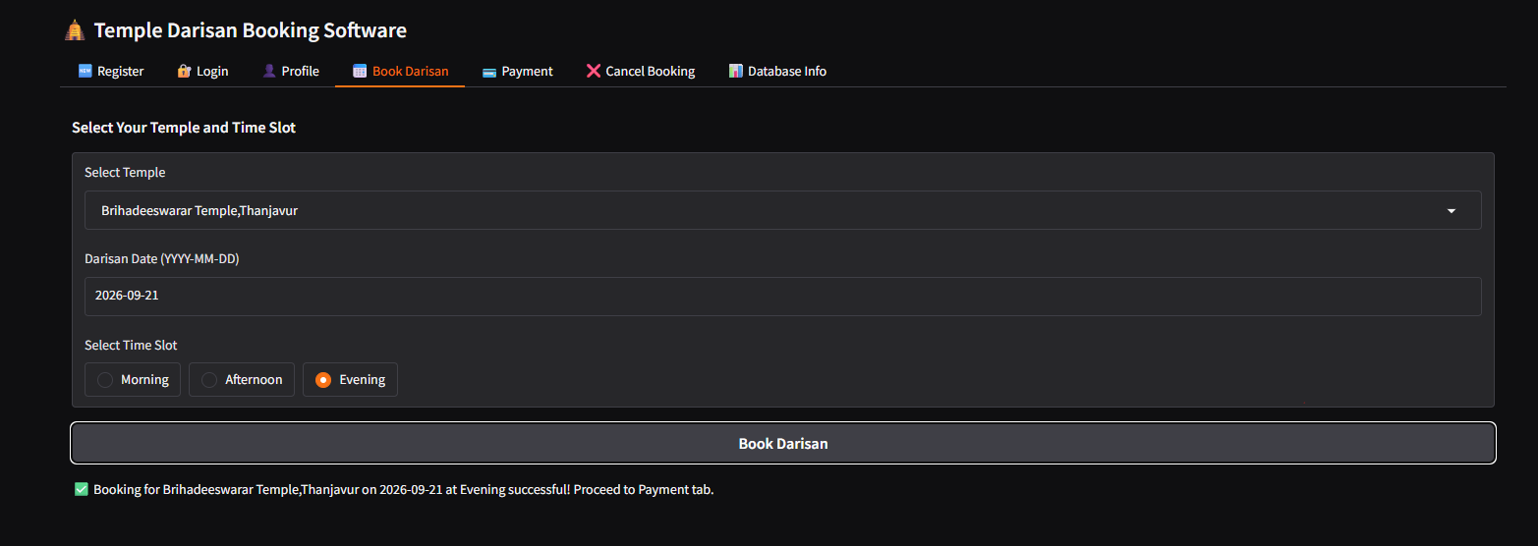
Screenshot
Booking Module

Slide 11
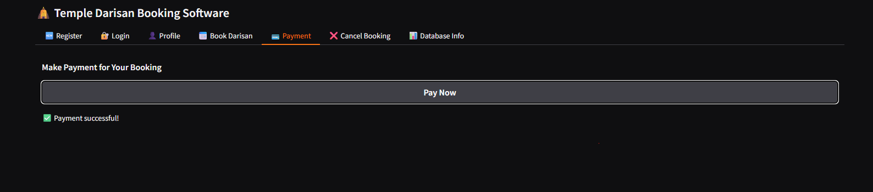
Screenshot
Payment Module

Slide 12
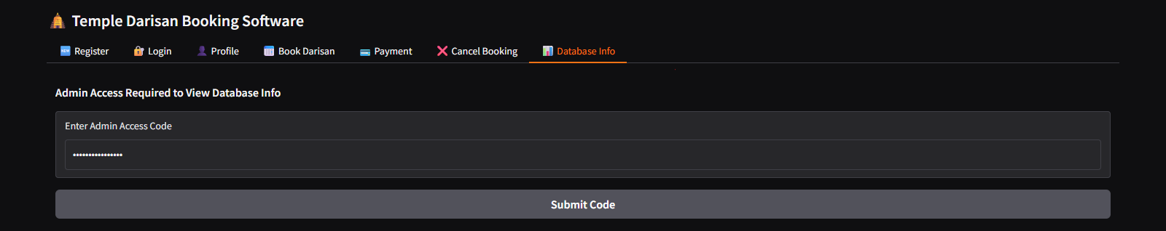
Screenshot
Database Viewer

Slide 13
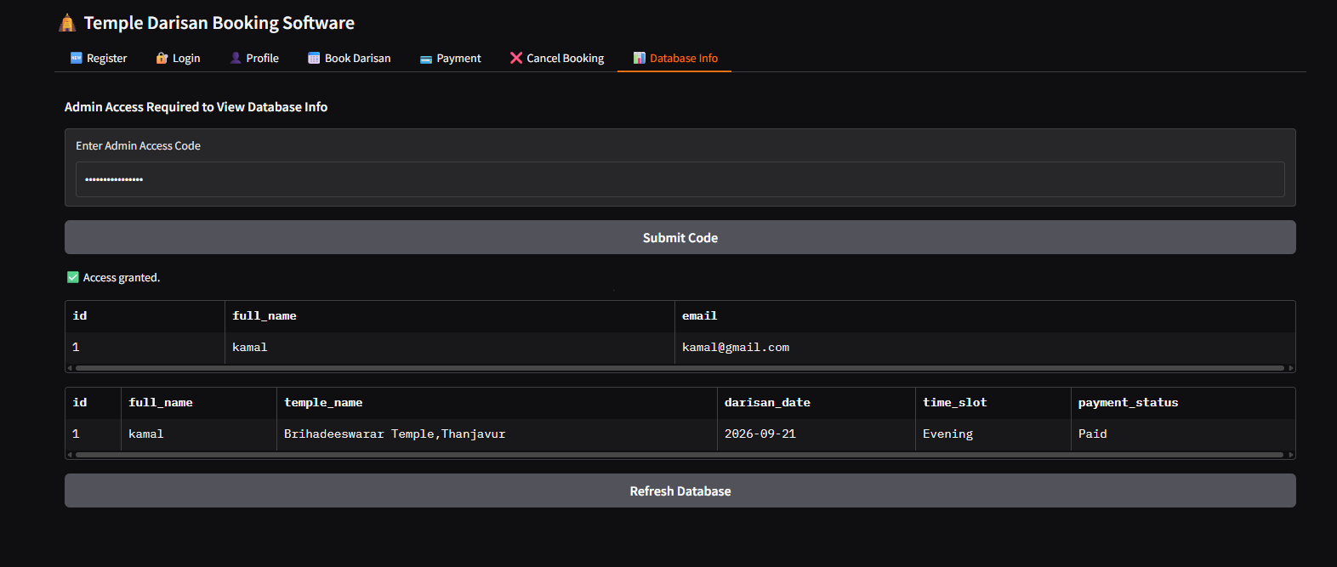
Screenshot

Slide 14
Conclusion And Future Enhancement
The Temple Darshan Booking App simplifies temple visits by digitizing the booking and payment process. It ensures a smooth and transparent user experience while giving temple administrators control over schedules and data.
Future Enhancements:
OTP/email-based login system.
Real-time availability view for slots.
UPI/QR code-based real payment gateway.
Mobile app version using Ionic or Flutter.
SMS/Email notifications for booking confirmation and cancellations.
Multi-language support for broader accessibility.

Slide 15
Thank You
ANY QUERIES???

